Slide 1
Leveraging Partnerships in a Tight Economy
Sandra Crumlish, MSA
scrumlish@sjm.com
2011 NCNMLG/MLGSCA Joint Meeting

Slide 2

Tight Economy, Dwindling Budgets, Threats to Resources
Management
Vendor
Customer
Library

Slide 3
Benefits of the Working Relationship
Library
Organization
Vendor
Partnerships
Customer Service
Level o

Slide 4












Library Support – 15,000 Employees
3500 Light Users
1500 Heavy Users
2500 Moderate Users

Slide 5

What are We Facing?
LIBRARY
RECRUIT

Slide 6
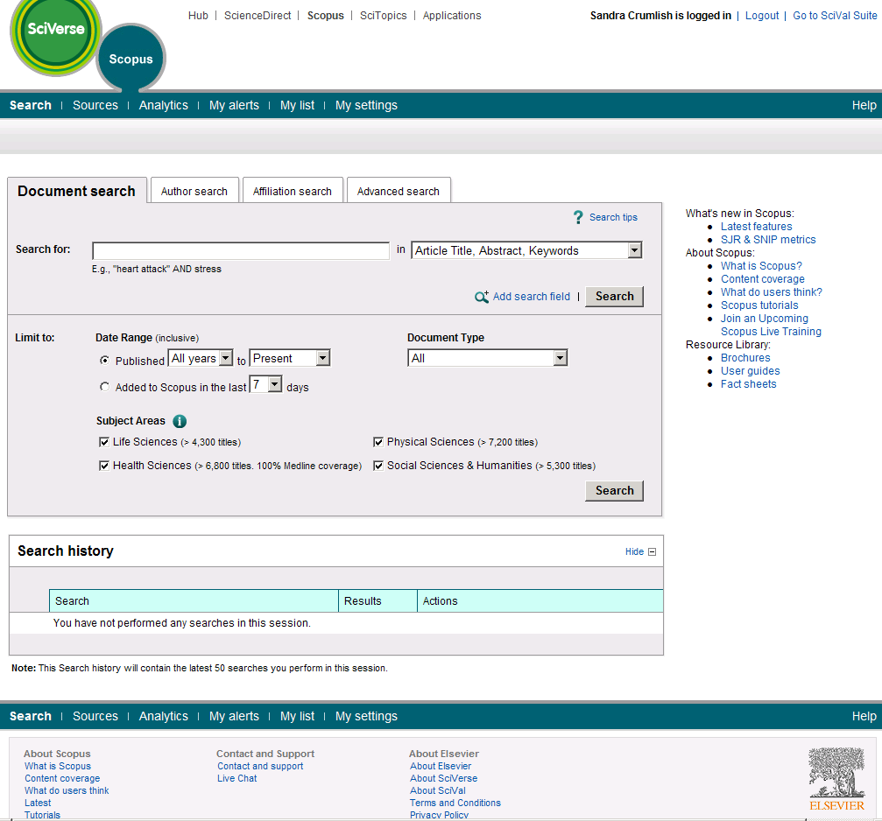
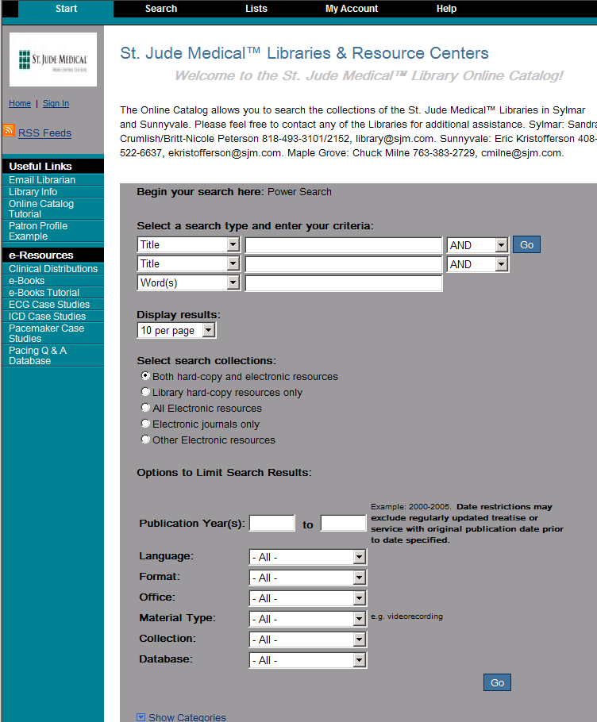
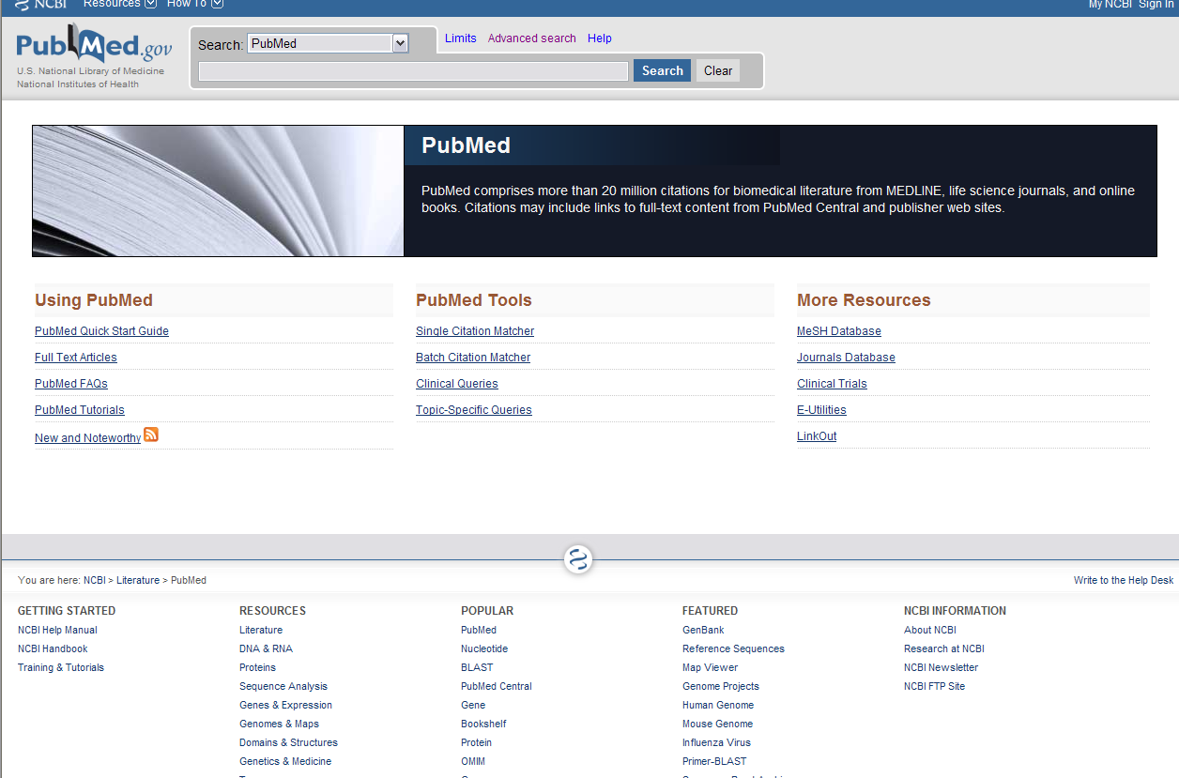
Pathway to Success
Strat Marketing
CSEs
Research
Clinical Studies
Regulatory

Slide 7
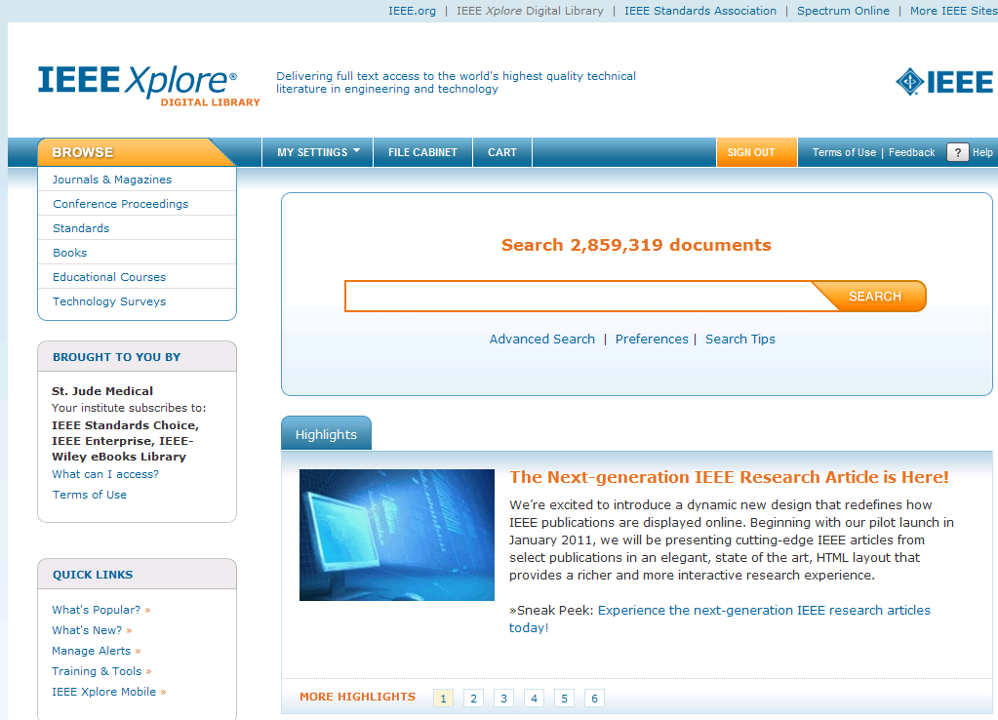
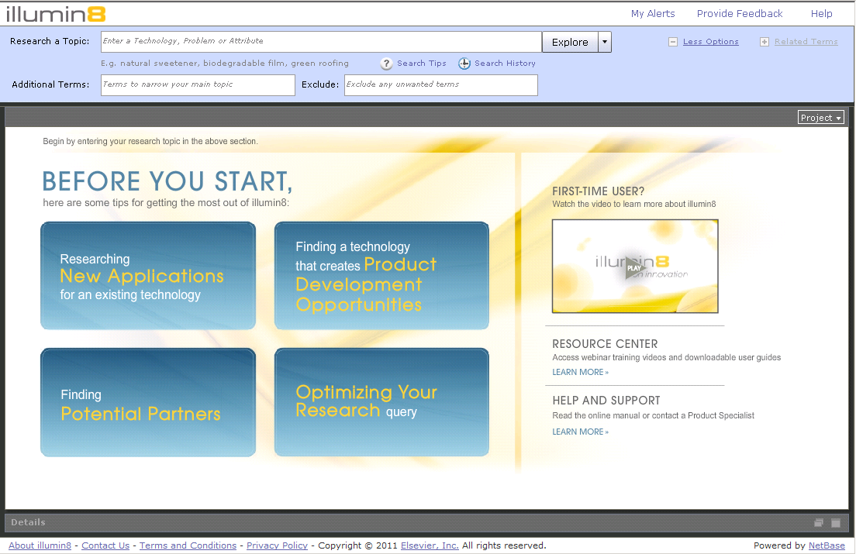
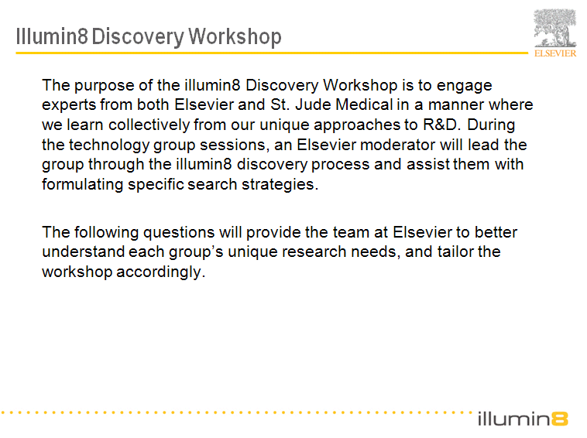
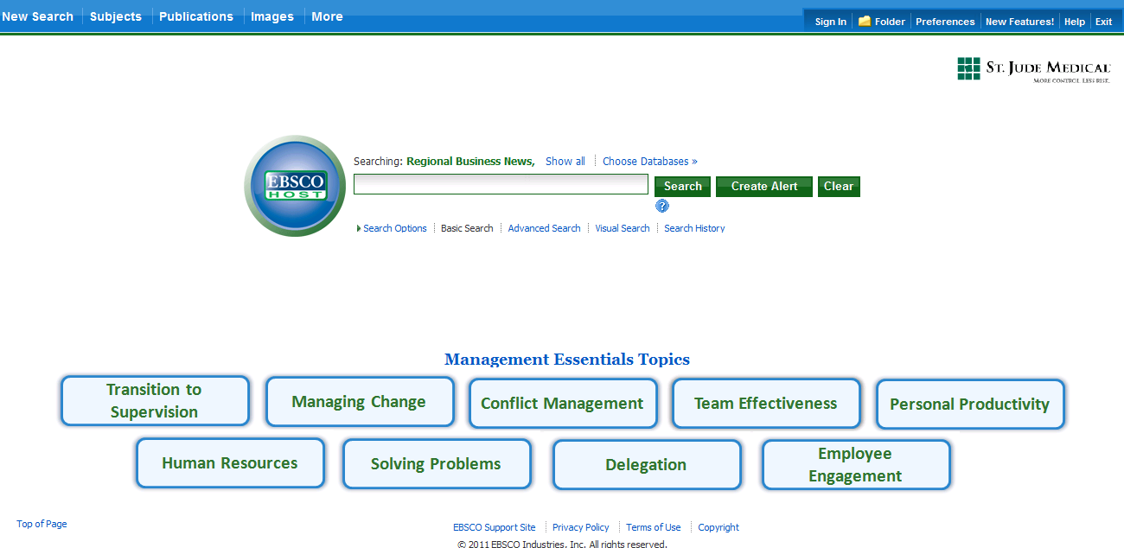
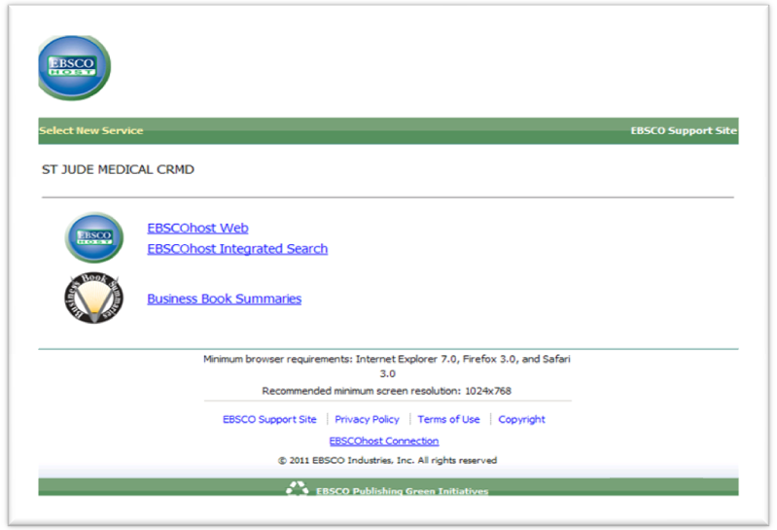
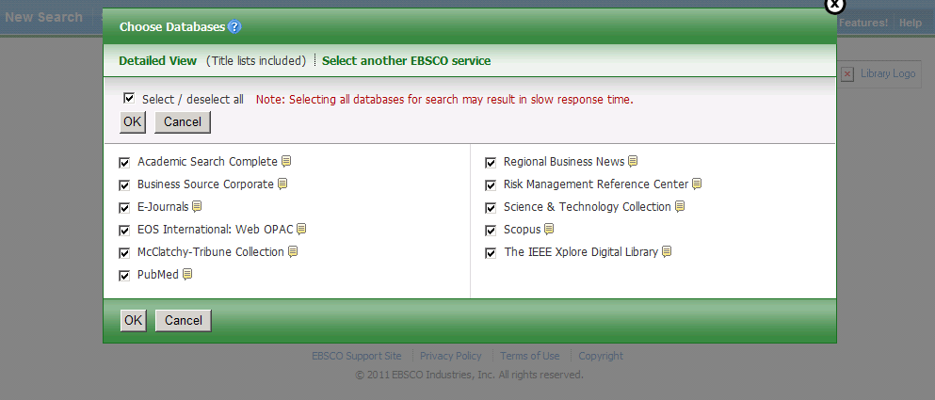
Vendor Extras

Slide 8
What Does This Mean?
Develop Partnerships
  Library-Vendor
  Library-SJM
  Vendor-SJM
Mutually Beneficial
Value - Future
  Trust
  Reciprocal Relationship
Organization
Vendor
Library
Continuous Improvement
  Organizational Goals
  User Satisfaction

Slide 9

Take the Leap!
Sandra Crumlish, Manager
Library & Resource Center
St. Jude Medical CRMD
scrumlish@sjm.com

